Slide 1
Compressive Tracking
Sara Maher

Slide 2
Agenda
Dimensionality Reduction
Principle Components Analysis
Random Projections
Compressive Tracking
Features
Classification
Remarks

Slide 3
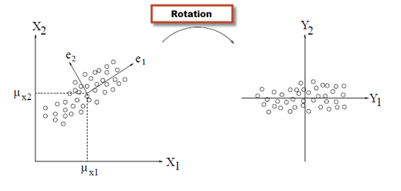
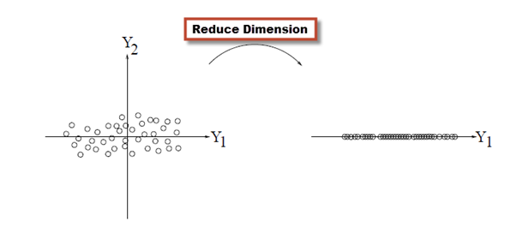
Principle Components Analysis(PCA)
Notes:
http://blog.rizm.io/2013/02/an-introduction-to-principal-component-analysis

Slide 4

Random Projections
Compressive Sensing
Recovery given:
Signal is sparse/compressible
Projection matrix must obey Restricted Isometry Property (RIP)
Bernoulli, Gaussian Distribution
[1]
[2]
[1] Decoding by linear programming; Candes, E.J. and Tao, T.
[2] Database-friendly random projections; Dimitris Achlioptas
Notes:
http://ieeexplore.ieee.org/xpl/login.jsp?tp=&arnumber=1542412
http://dl.acm.org/citation.cfm?id=861189

Slide 5
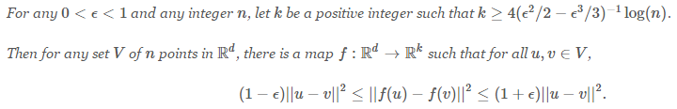
Random Projections
[1]
Johnson–Lindenstrauss lemma
Given a number of data points, n, that we wish to project and a relative error, ϵ, that we are willing to tolerate, we can compute a minimum dimensionality, k, that a projection must map a space into before it can guarantee that distances will be preserved up to a factor of ϵ.
[1] Extensions of Lipschitz mappings into a Hilbert space; William B. Johnson and Joram Lindenstrauss.

Slide 6
Random Projections
Data-independent (new point → no change in projection/mapping)
Distances perseverance

Slide 7
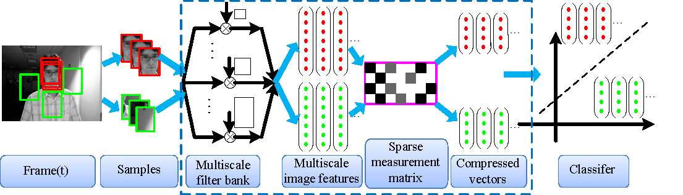
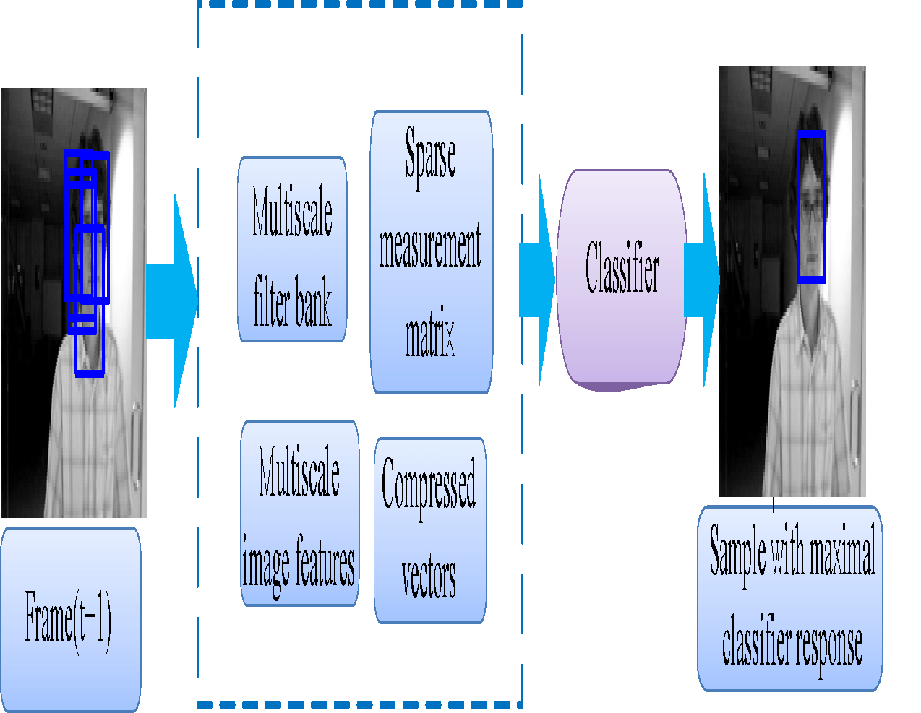
Compressive Tracking

Slide 8

Features
Projection Matrix construction (once)

Slide 9


Classification
Naïve Bayes Classifier

Slide 10
Remarks
+ side:
Real-Time
Spatially localized filters (less sensitive to occlusion)
- side:
Small number of projected features is used (n=50, bound=1600), the results are dependent on the generated random matrix .
Average n = 50 500 error 24.7 20.3 SD 12.2 7.5
Scaling unaware (update with false positive features or discard true positive)

Slide 11
Thanks

